Slide 1
Tattoo Ink Toxicity Revealed
BY
Lauren Whittaker & Gurwinder Bath
Toxicology
Winter 2014

Slide 2

Is tattoo ink safe and if not how toxic is it to the body?

Slide 3
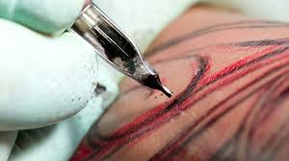
“Tattooing is followed by an initial inflammatory reaction that subsides within one to two weeks but persistence of inflammation beyond this period should be investigated. Histology is usually required to assess the pattern of tissue reaction to the pigment. Pigment particles may be seen in histological sections in a limited number of cases; in others, complex immunohistochemical procedures may have to be performed to find out the antigen; in yet others, the antigen may not be detected at all.” [3]

Slide 4
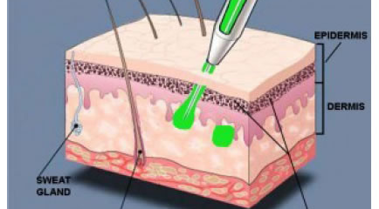
The mechanism of action…
The body “Heals” the ink into place

Slide 5

What is your toxin? What is its chemical structure and what natural compounds does it mimic?

Slide 6
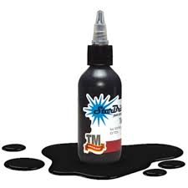

Our research showed that tattoo ink is not approved by the FDA or any regulating agency. Which means, every tattoo artist uses their unique mixture of the ink. So with this project we will focus on black ink.

Slide 7
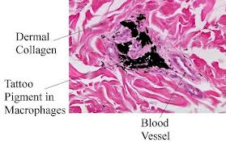
Black ink is a carbon based substance. Ingredients are soot, PAHs (polycyclic aromatic hydrocarbons) which have benzo(a)pyrene and phenol and phthalate. Heavy metals could be continued in the ingredients listed above such as lead, cabmium, chromium, nickel, titanium, and other heavy metals.

Slide 8
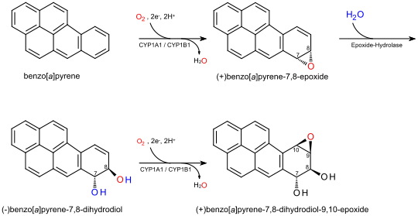
PAHs (polycyclic aromatic hydrocarbons) Benzo(a)pyrene

Slide 9

Where is it found and how are individuals exposed to the toxin?

Slide 10
Cooking meat in open flame, tar, coal, and fossil fuels any combustion reaction, black tattoo ink.
Through combustion of wood, coal, incense, diesel, tobacco smoking.

Slide 11
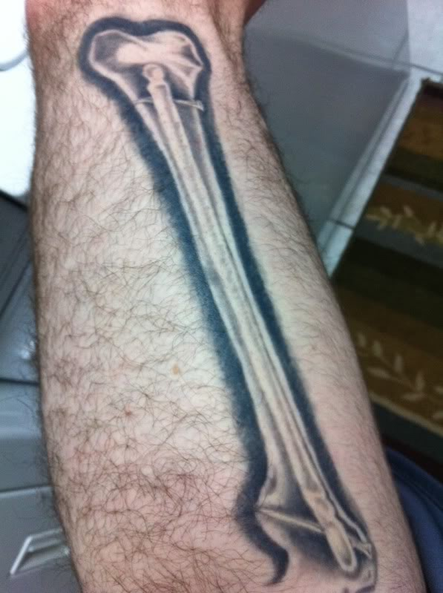

What are the target organ(s) of injury?
Tissues with rapid replicative turnover have higher susceptibility: bone marrow, skin, lung tissue
Tissues with slower turnover rates are less susceptible: liver tissue.

Slide 12

What is the dose-response for toxic action and injury?
PAH-induced carcinogenesis can result when a PAH-DNA adduct forms at a site critical to the regulation of cell differentiation or growth. A mutation occurs during cell replication if the aberration remains unrepaired.

Slide 13
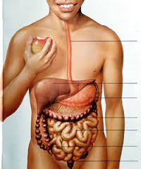
How is the toxin metabolized and eliminated from the body?
Distribution
Once absorbed, PAHs
enter the lymph,
circulate in the blood, and
are metabolized primarily in the liver and kidney.

Slide 14
Mechanism and excretion
PAHs are predominantly metabolized via CYP enzymes in the liver. In addition to the liver and kidneys, metabolism of PAHs occurs in the adrenal glands, testes, thyroid, lungs, skin, sebaceous glands, and small intestines.
PAHs are transformed initially to epoxides, which are converted to dihydrodiol derivatives and phenols. Glucuronide and sulfate conjugates of these metabolites are excreted in the bile and urine.

Slide 15
Half Life
Excretion half-lives in feces and urine have been reported in animal studies as 22 hours and 28 hours, respectively

Slide 16
What is the risk of exposure and how prevalent is the exposure to the public?
This toxin is lipophilic and crosses the cell membrane with ease. So once it is in the cell the DNA of the cell is exposed to the toxin. At this point if cell replication is altered due to exposure to the toxin and alteration is unrepaired the mutation occurs. This toxin is extreamly carcinogenic.
Toxins for all PAH’s are not the same. Benzo(a)pyrene is one of the most toxic. PAH-DNA adduct forms at a site critical to the regulation of cell differentiation or growth.

Slide 17

What components of care management will eliminate or reduce the risk of adverse events from the exposure to this toxin?

Slide 18

Body detox, heavy metal chelation treatments, glutathione IVs or topical, Eat a whole foods non toxic, non gmo diet. Eliminate processed foods. Drink clean fresh water everyday.

Slide 19
References
1. Kashyap, Subhash, Vinay Shanker, and Uday Khopkar. "Granuloma Annulare-like Palisading as a Histological Reaction to a Tattoo." Indian Journal of Dermatology, Venereology, and Leprology 80.5 (2014): 465-67. Print.
2. "Toxicity of Polycyclic Aromatic Hydrocarbons (PAHs)." Agency for Toxic Substances and Disease Registry (ATSDR), 1 July 2009. Web. 20 Nov. 2014.
3. Israel, Brett. "Inkling of Concern: Chemicals in Tattoo Inks Face Scrutiny." Environmental Health News. 31 Aug. 2011. Web. 15 Nov. 2014.

